Slide 1

SIGMA PI PHI FRATERNITY
BETA KAPPA BOULÉ
SOCIAL ACTION PROGRAM
BOULE SCHOLARS 2020-21

Slide 2

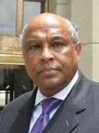
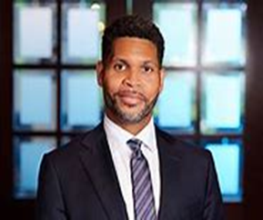
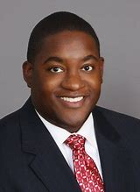
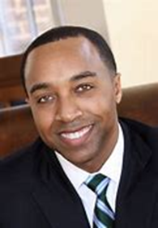
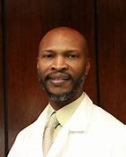
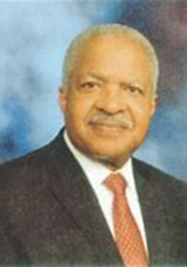
Sire Archon Attorney Tom Larkin
- Civil Rights Attorney
Archon Foster Ware III (Co-Chair)
- Chemical Engineer currently serving in a Leadership role with Alabama Power
Archon Willie Gilford, MD (Co-Chair)
- Associate Professor,
Medical Director and
Emergency Physician at UAB
Sigma Pi Phi Fraternity, Inc.
2020-21 Boule’ Scholars Program
Leadership Team
Archon Attorney Derrick Mills
- Committee Member
- Partner with Marsh, Rickard, & Bryan Law Firm
Archon Corey Hartman, MD
- Immediate Past Social Action Committee Chair
-Board Certified Dermatologist and
Founder of The Skin Wellness Center
Archon Issac Ravizee, MD
- Beta Kappa Boule’ Foundation Chair
-Retired OB/GYN after long illustrious career

Slide 3

Beta Kappa Boule’ Scholars Program
Activities 2020-21
Fall Virtual Sessions
Spring Virtual Sessions
10/24 Scholar Orientation & Current Events Discussion
11/7 Medical Careers & Drug and Sex Talk
11/21 Entrepreneurship & Personal Finance
12/5 Public Safety & Police Interactions
1/16 Public Speaking & Interview Techniques
1/30 Time Management & Study Habits
2/13 Etiquette
3/13 Legislative Process Overview
4/13 Law Careers
4/24 Engineering & Technology
May Awards Banquet

Slide 4
Boule’ Scholars Agenda
November 7, 2020
10:00 -10:05 Introductions / Roll Call
10:05 -10:15 Current Events/Open Talk
10:15 -10:40 Medical Careers Panel 10:40-11:20 Speaker “Drugs and Sex”
11:20 -11:25 Q&A/ Mentoring
11:25 -11:30 Up-Dates/Wrap up

Slide 5
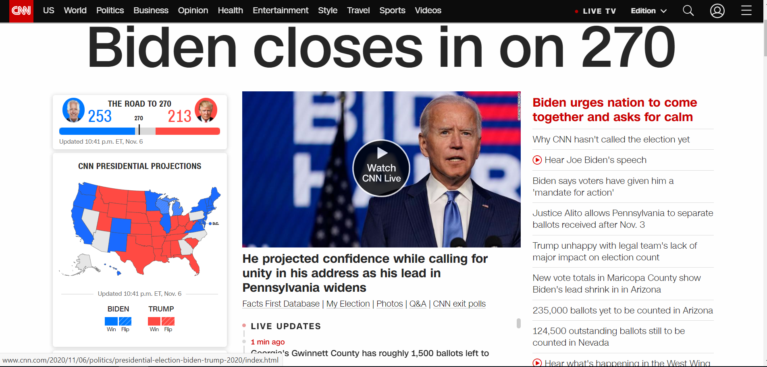

Slide 6
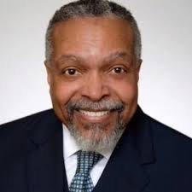
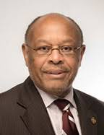
DENTISTRY
Archon Adolphus Jackson, DMD
-Founder West Princeton Dental Clinic
- Former Member State of Alabama Dental Board
VETINARY MEDICINE
Archon Jerome Williams, DVM
- Founder of Red Mountain Animal Clinic
-Board Chair and President Pro Tem Alabama A&M
Sigma Pi Phi Fraternity, Inc.
2020-21 Boule’ Scholars Program
MEDICAL CAREERS PANEL

Slide 7
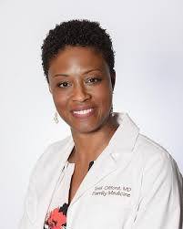

PHYSICIAN ASSISTANT
Archousa M. Tosi Gilford, MD, PA-C
-Assistant Professor UAB School of Health Professions
- Director UAB Physician Assistant (PA) Program
PHYSICIAN/ DOCTOR OF MEDICINE
Archon Issac Ravizee, MD
- Beta Kappa Boule’ Foundation Chair
-Retired Obstetrician & Gyb=necologist
Sigma Pi Phi Fraternity, Inc.
2020-21 Boule’ Scholars Program
MEDICAL CAREERS PANEL

Slide 8
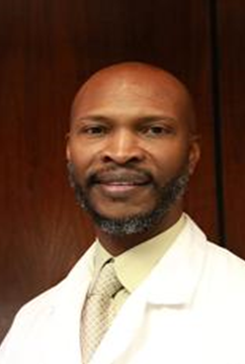
Speaker Highlight
Dr. Willie L. Gilford, Jr., MD is a board certified Emergency Physician and a Fellow of the American College of Emergency Physicians. He is a native of Selma, AL where he finished Selma High School in 1989. He attended college at Dillard University of New Orleans where he graduated with a B.S. in Chemistry in 1993. He obtained his Medical Degree from Meharry Medical College in Nashville in 1997, and completed an Emergency Medicine residency at King/Drew Medical Center in Los Angeles in 2000. Since July 2000 he has been on the Faculty of Emergency Medicine at the University of Alabama, Birmingham [UAB] where he has been a core faculty and assistant residency program director. He is currently an Associate Professor and is the inaugural Medical Director of UAB Gardendale Freestanding ER. His interest include minority disparities in medicine and mentoring. He recently became a Board member of Commercial Development Authority for the city of Birmingham. He is also a State of Alabama licensed home builder.
He is married to Monifa T. Gilford, MD an Assistant Professor in the School of Health Professions at UAB and Director of the Physician Assistant Program. They have 4 children.

Slide 9

Ice Breaker
Kahoot Survey
Kahoot.it

Slide 10

Each Scholar to give brief personal update since last workshop.
Brainstorm about Individual and Group Projects
Kahoot Survey
Updates and Planning

Slide 11
Boule Scholars Agenda
November 7, 2020
11:20 -11:30 Up-Dates/Wrap up
Next Work-Shop November 21, 2020

