Slide 1

SIGMA PI PHI FRATERNITY
BETA KAPPA BOULÉ
SOCIAL ACTION PROGRAM
BOULE SCHOLARS 2020-21

Slide 2

Boule Scholars Agenda
October 24th
10:00 -10:15 Introductions
10:15 -10:30 Ice breaker
10:30 -11:15 Speaker - Voting History
11:15 -11:20 Program Expectations
11:20 -11:30 Program Dates/Wrap up

Slide 3
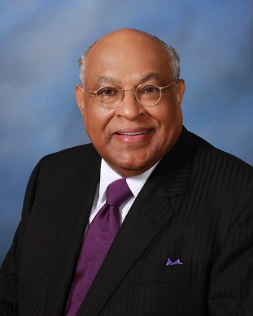
Dear Beaus:
Congratulations on your selection to participate in the Beta Kappa Boulé Beautillion. The Beautillion is our signature social action program for the development and exposure of young men who show leadership potential. As a Beta Kappa Boulé “Beau” you will have exposure to members of the Fraternity who you will hear referred to as “Archon.” Although many of our members are noted physicians, dentist, attorneys, judges and other noted professions, they are all referred to as “Archon.”
Your application and acceptance into the program indicate that you are a high achiever and purpose driven. The Social Action Committee has prepared a course syllabus that is designed to give you in depth knowledge and even skills that will stay with you for a lifetime. I encourage you to stay engaged and ask questions.
You are our future leaders. There is not better way for us to have highly effective leaders than to grow our own. We believe in you. I look forward to your participation in the Beautillion.
Sincerely,
Sire Archon Tom L. Larkin

Slide 4

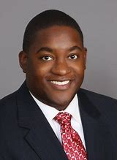
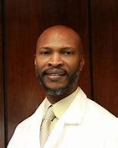
Sire Archon (President) Attorney Tom Larkin
- Esteemed Civil Rights Attorney for over 40 years in Private Practice
Archon Foster Ware III (Co-Chair)
- Chemical Engineer currently serving in a Leadership role with Alabama Power
Archon Willie Gilford, MD (Co-Chair)
- Associate Professor, Medical Director, and Emergency Physician at UAB
Sigma Pi Phi Fraternity, Inc.
2020-21 Boule’ Scholars Program
Leadership Team

Slide 5
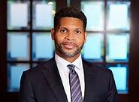
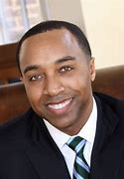
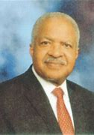
Archon Attorney Derrick Mills
- Committee Member
- Partner with Marsh, Rickard, & Bryan Law Firm
Archon Corey Hartman, MD
- Immediate Past Social Action Committee Chair
-Board Certified Dermatologist and Founder of The Skin Wellness Center
Archon Issac Ravizee, MD
- Beta Kappa Boule’ Foundation Chair
-Retired OB/GYN after long illustrious career
Sigma Pi Phi Fraternity, Inc.
2020-21 Boule’ Scholars Program
Leadership Team

Slide 6

Name
School
Career Aspirations
Favorite Recording Artists
Favorite Song
Introductions

Slide 7

Ice Breaker
Kahoot Survey
Kahoot.it

Slide 8
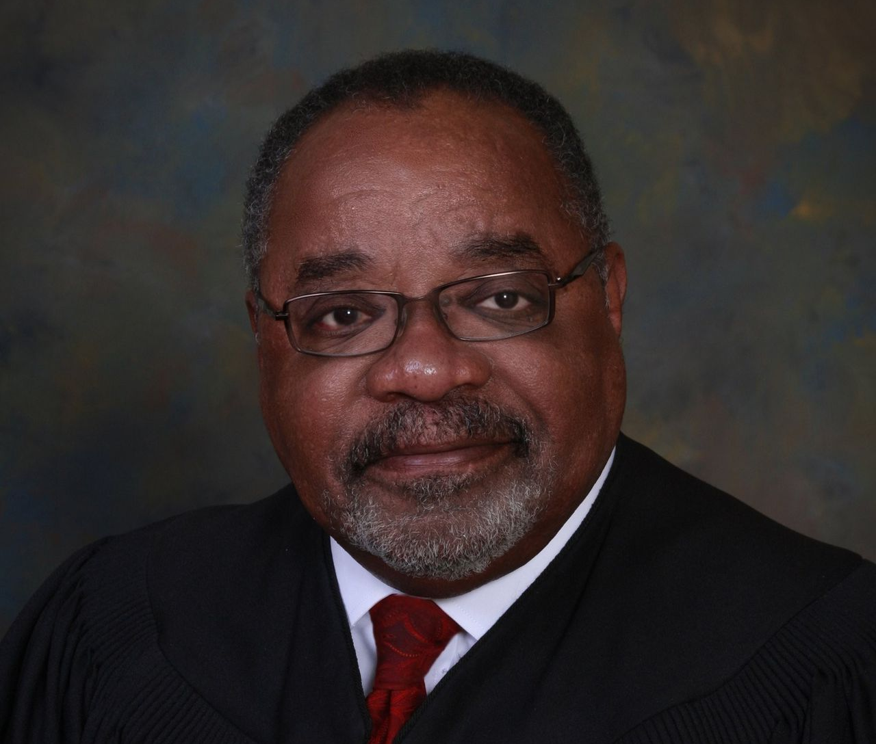
Speaker Highlight
Judge Houston Brown, retired presiding judge for the 10th Judicial Circuit of Alabama, is a native of Birmingham and graduate of A. H. Parker High School.
Holds a bachelor of arts degree in Economics from Talladega College and a J.D. degree from the Cumberland School of Law at Samford University.
He has practiced law in Jefferson County since 1973 and is married to Betty Winston Brown. They have two adult sons and five grandchildren.

Slide 9
Beta Kappa Scholars Program
Activities 2020-21
Fall Virtual Sessions
Spring Virtual Sessions
10/24 Scholar Orientation & Current Events Discussion
11/7 Medical Career Overview
11/21 Entrepreneurship & Personal Finance
12/5 Public Safety & Police Interactions
1/16 Public Speaking & Interview Techniques
1/30 Time Management & Study Habits
2/13 Etiquette
3/13 Legislative Process Overview
4/13 Law Careers
4/24 Engineering & Technology
May Awards Banquet

